Slide 1


Competition Eurobot Team (S2) Sneaky Squirrel
Team Members:
Julien NOIREAUX-FATTAZ,
Karam DALI,
Melchior BAUDOIN,
Muhammed-Adeel KHAN,
Zakaria LATRECHE

Slide 2
Table of Contents
1 – Strategies & Objectives.
2 – Technical Challenges.
3 – System Architecture.
4 - Mechanical Design.
5 – Project Management.

Slide 3
Strategies & Objectives
Find the hazelnuts and move toward them (prioritising the nearest one).
Differentiate between our team and enemy team hazelnuts (giving priority to ours).
Colour recognition will be used to identify the hazelnuts.
If a hazelnut crate is not of our colour, the robot will flip it
Every 6 points scored, the robot’s role will be leveraged to verify the cursor position (the cursor must be centred).
We will rely on a camera, ArUco codes, and a localisation system.

Slide 4
Technical Challenges
Continuous Live Tracking: Precisely track the robot, all hazelnut crates, and the opposing robot's position and trajectory in real-time.
Dynamic Navigation: Use a robust path-planning algorithm that updates to avoid moving and static obstacles.
Simple & Robust Hardware: Employ a minimalist mechanical design with a colour-actuated gripping mechanism.
Monitor the crate count in the nest (max 6) and track the fill status of the pantries.
Efficient Strategy: An algorithm calculates the optimal destination for each crate based on the lowest transport cost.

Slide 5
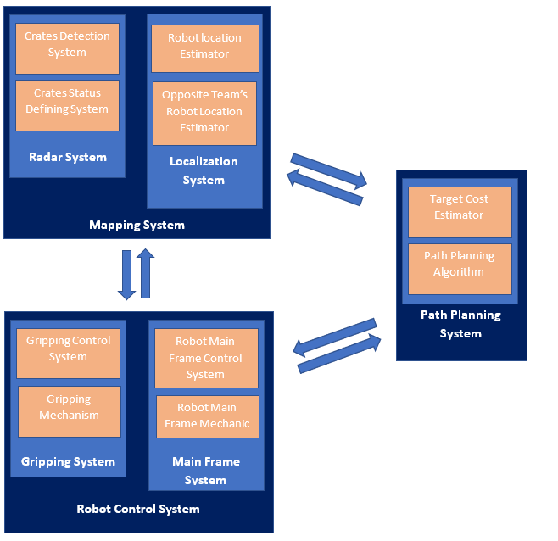
System Architecture
Mapping System
Path Planning System
Robot Control System
Figure 1 : System Architecture

Slide 6
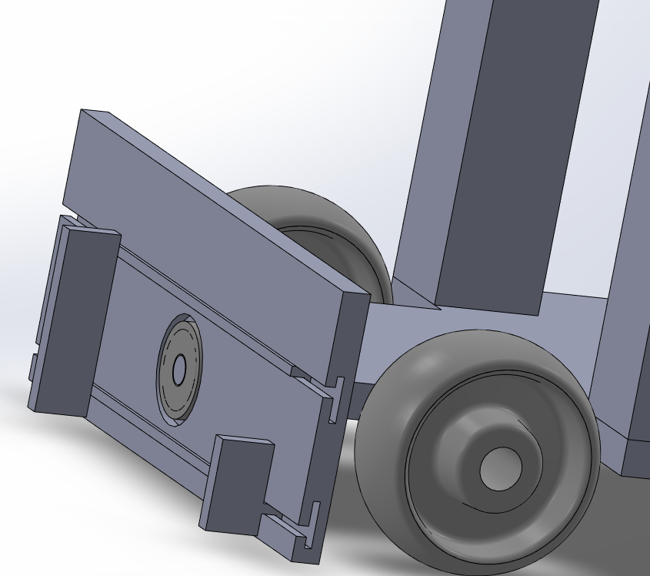
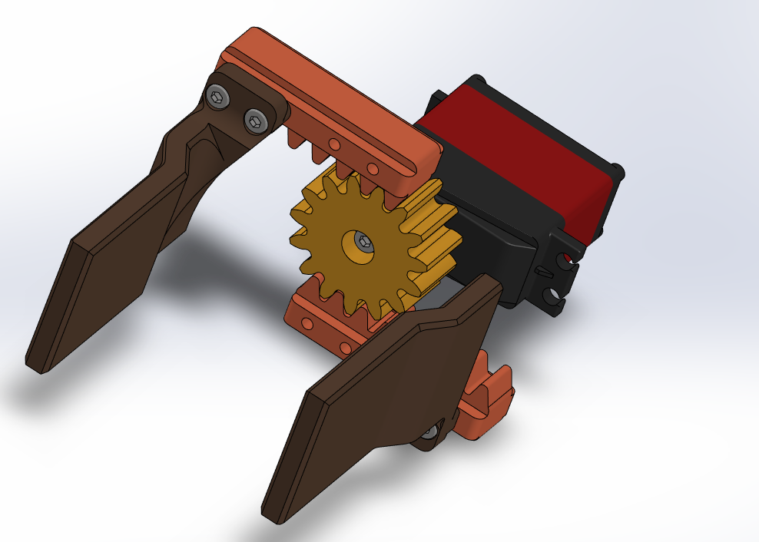
Mechanical Design
Figure 2 : 1st Design.
Figure 2 : 2end design.

Slide 7
Project Management
Task | Start Date | End Date | Status | Responsible
Kick off meeting with team members | 25/09/2025 |  | Done
Electrical parts picking | 6/10/2025 | 20/10/2025 | In Progress | Julien, Zakaria
Rules summery | 25/09/2025 | 29/09/2025 | Done | Team Members
Mechanical approach | 29/09/2025 | 18/11/2025 | In Progress | Adeel, Melchior
Fork the main repo | 29/09/2025 | 6/10/2025 | Done | Julien
Gazebo simulation |  |  | To Do | Zakaria
Localization system | 29/09/2025 | 25/12/2025 | In Progress | Karam

